Slide 1
First Program
1.4-1.7

Slide 2
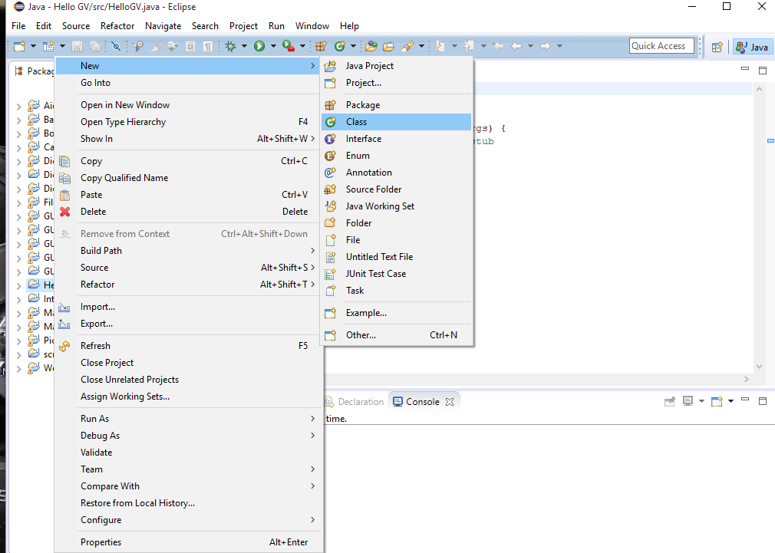
Hello GV Creating the class
When creating a new class, the naming convention for a class is that it must start with a capital letter.

Slide 3
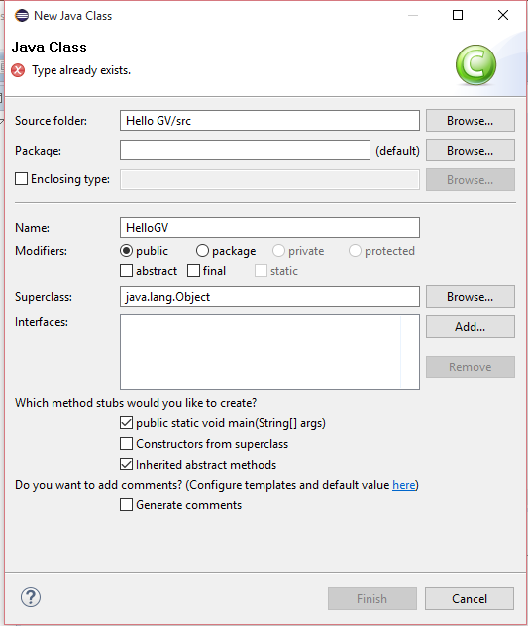
Main Method
Tell eclipse that you want to class to have a main method

Slide 4
Create the program

Slide 5
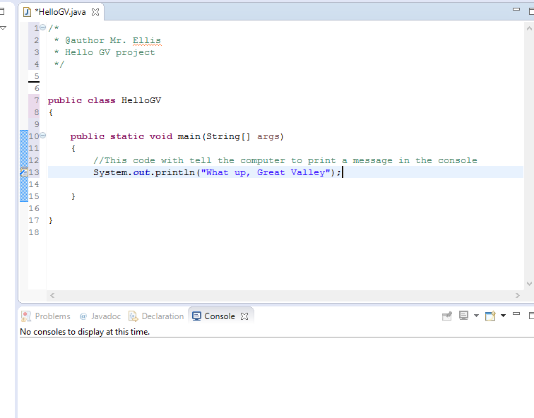
Discuss

Slide 6
Errors
Compiler error (syntax error)
Error picked up by the compiler. You will get an explanation which will help you to correct the error
Run-time error
Created by logical flaws. They can be more difficult to track down and correct.
Some create exceptions which is an error message generated by the JVM

Slide 7
Algorithms
An algorithm is a series of steps which can be used to solve some sort of problem.
In programming an algorithm must be unambiguous, executable, and terminating.
Pseudocode – writing out instructions in plane English help organize the setup of your program.

Slide 8
Example
Write an algorithm in pseudocode which will find how many years it will take an investment to reach a value of $20,000 compounded annually at 5%

Slide 9
homework
Write pseudocode to find the largest number in a list of numbers
Write an eclipse program which will display a smiley face
///////
(| o o |)
| ^ |
| ‘_’ |
+---------- +

